Slide 1
Retrograde
A Virtual Exhibition
Proposed & Presented By: Group 3
Hon Xin Yi Winnie S10195165C
Clare Tay Jie Ying S10196574K
Malbas Kasey Soh S10196379C
Soo Hwee En S10196707H
Sean Goh Jun Wei S10197933B

Slide 2
Table Of Contents
01
03
02
04
Exhibition Layout/Flow & Programme
Key Objectives & Outcomes
Content Concept & Theme
Target Profile & Visitor Motivations

Slide 3
01
Key Objectives & Outcomes

Slide 4
Key Objectives & Outcomes:
Objective 1: | Outcome 1: | Objective 2: | Outcome 2:
Educational Value | Educational Value | Sentimental Value | Sentimental Value
To introduce Youths to past local recreational activities | For Youths to discover and learn more about past-time recreational activities and their significance towards our local arts industry | To bring Youths on a nostalgic trip down memory lane | For Youths to tap into sentimental value whilst forming deeper connections to our past roots

Slide 5
02
Content Theme & Concept

Slide 6
Exhibition Content Theme & Concept:
Target Audience:
Youths (16 to 25 years old)
Inspiration:
Theme:
Concept:
Collections from roots.sg: olden theme parks & playground proto-type drawings
Recreational Activities: Playgrounds & Theme Parks
Gamification

Slide 7
Exhibition Title:
Programme Title:
‘Retrograde’
‘Kickback’
A play on the word “retro” (recent past) while “retrograde” itself means directing or moving backwards
A play on the phrase “kick back” which means a kick back in time
It is proposed that a series of photographs of 7 past and present iconic and recognised playgrounds and theme-parks will be exhibited.

Slide 8
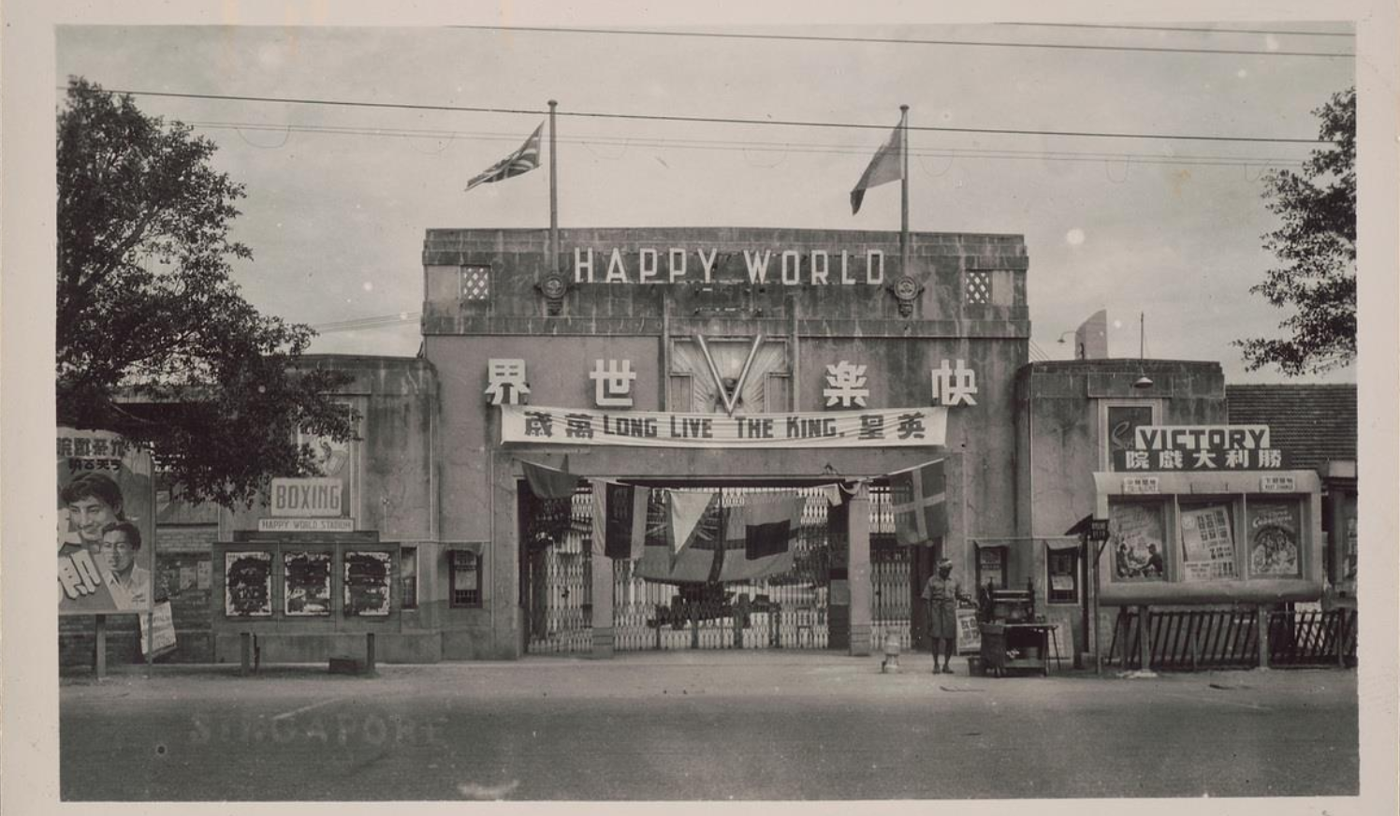
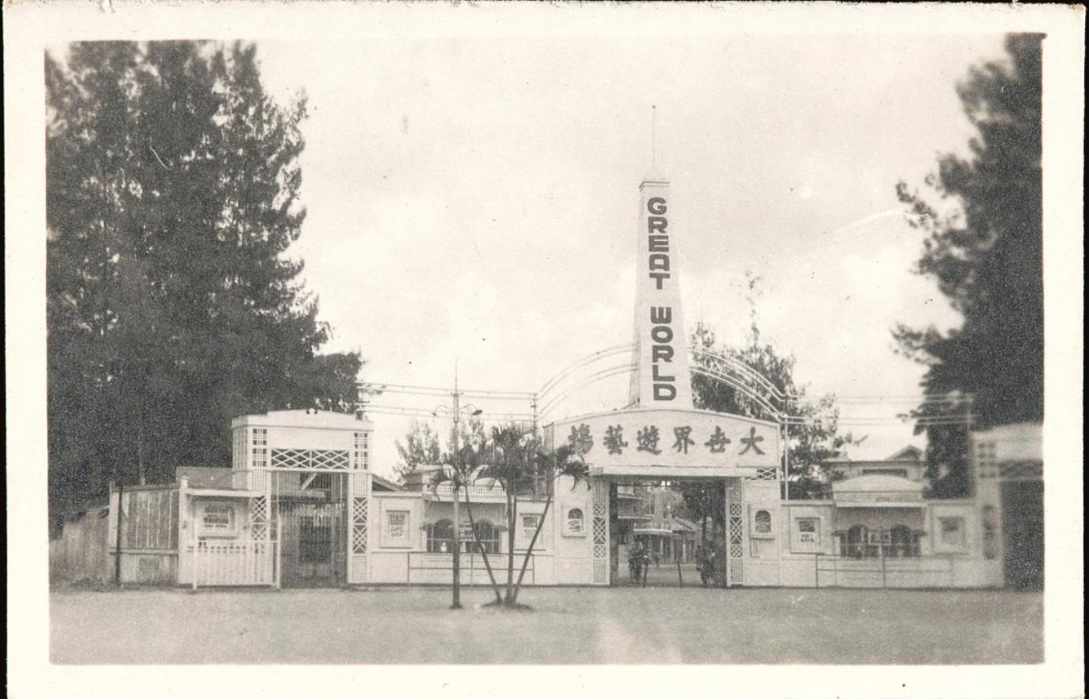
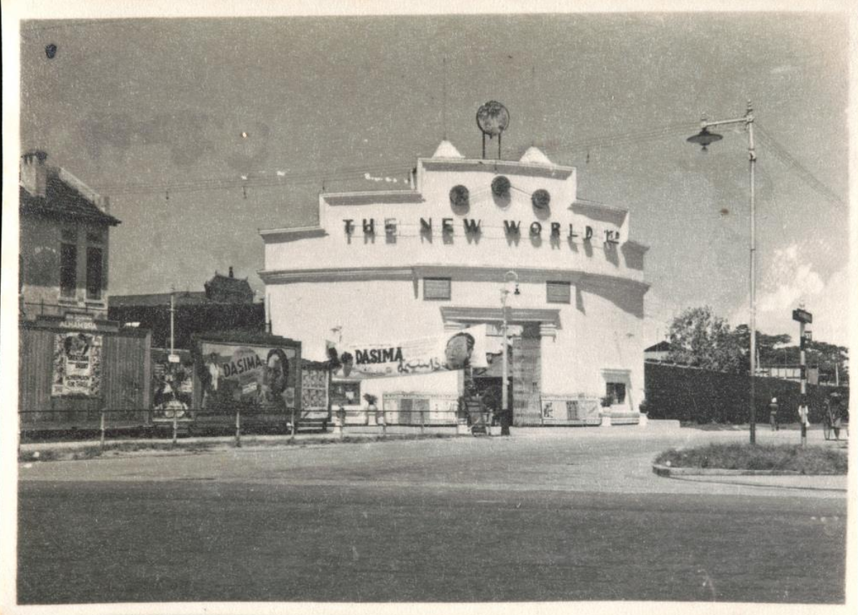
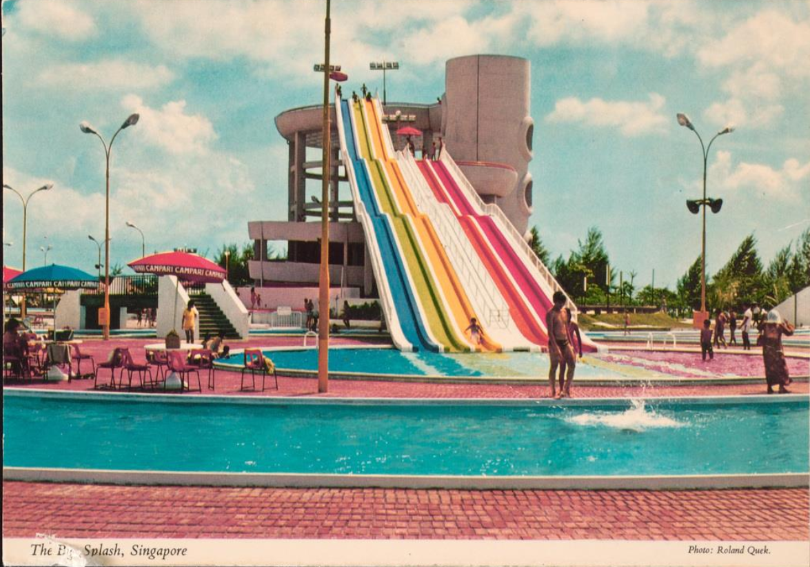
Exhibition Content: Theme-Parks (Past)
1
2
3
4
Happy World Amusement Park
Great World Amusement Park
New World Amusement Park
The Big Splash Aquatic Centre
(Roots, n.d.-d)
(Roots, n.d.-a)
(Roots, n.d.-b)
(Roots, n.d.-g)

Slide 9
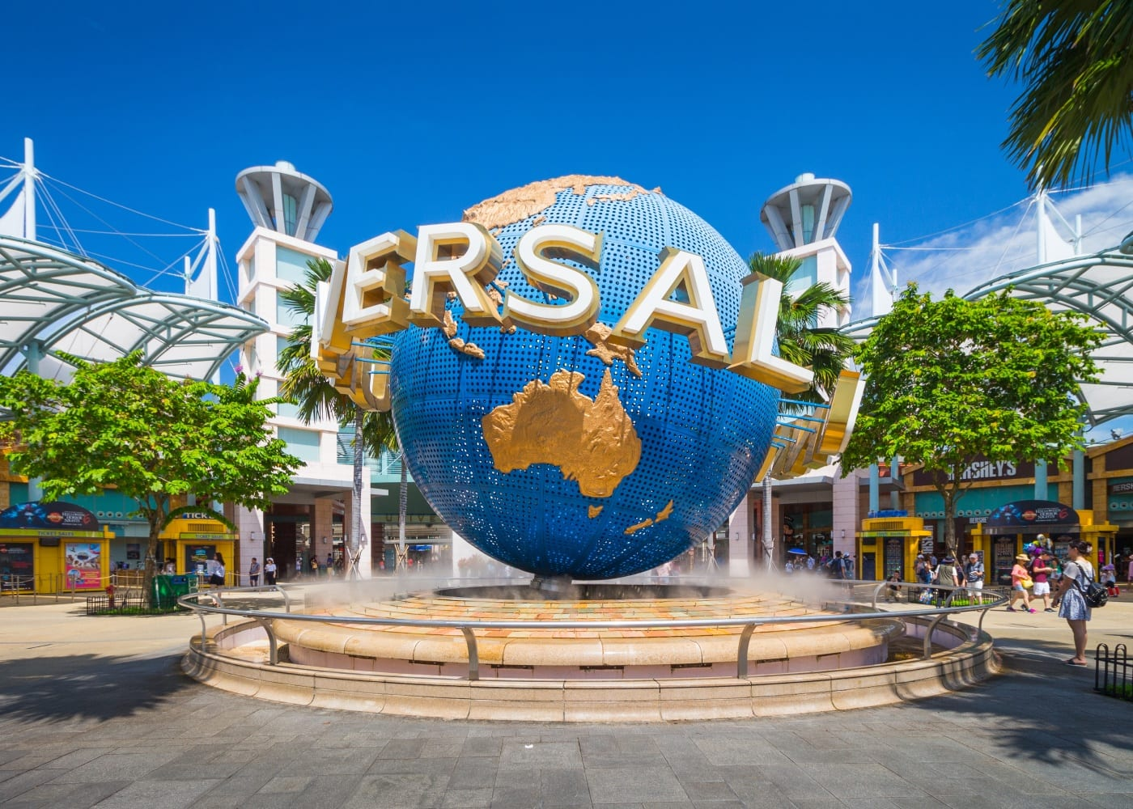
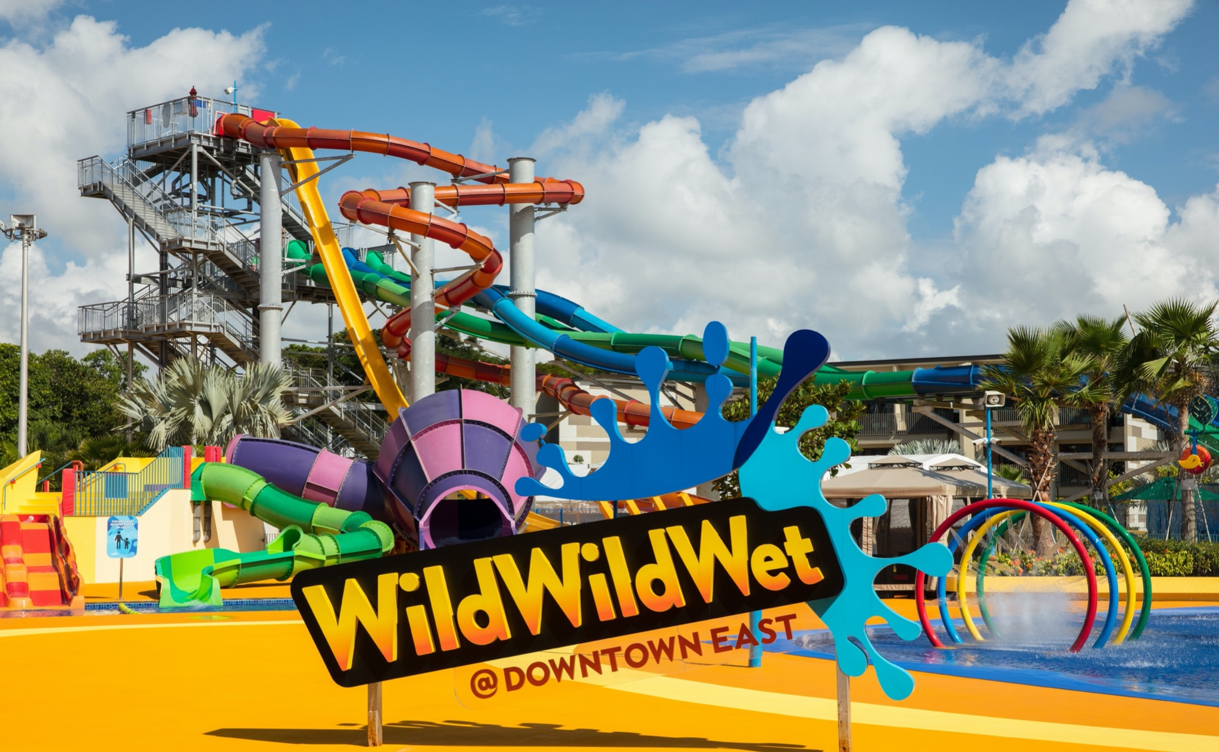
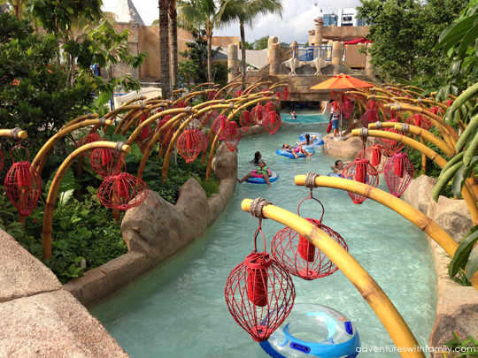
Exhibition Content: Theme-Parks (Present)
1
2
3
Universal Studios Singapore (USS)
Wild - Wild - Wet
Adventure Cove
(Tristram, 2019)
(Wild Wild Wet, n.d.)
(Rosie, n.d.)

Slide 10
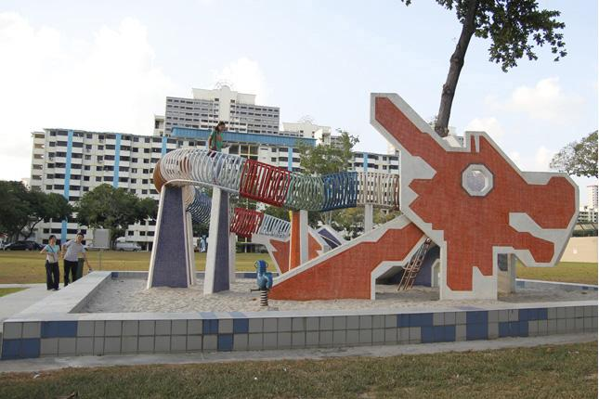
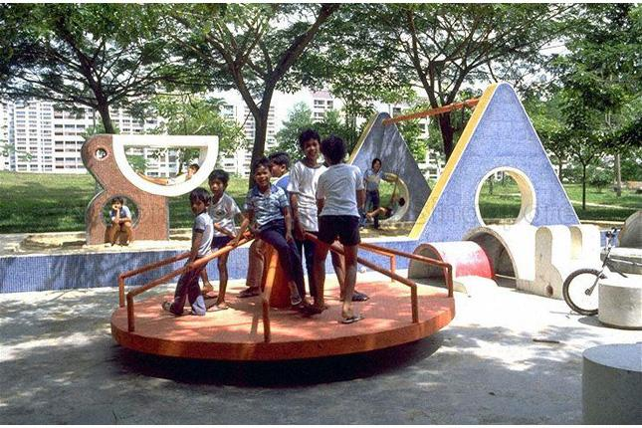
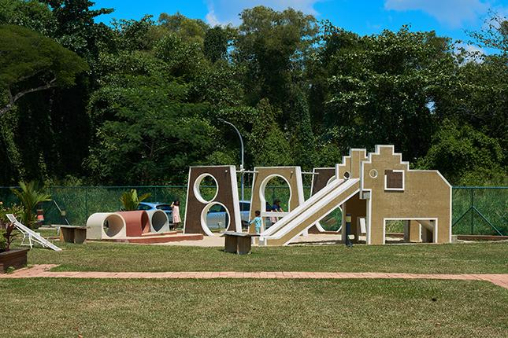
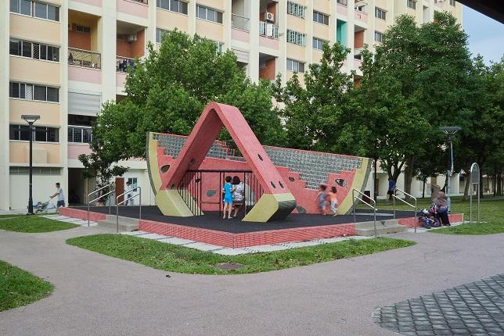
Exhibition Content: Playgrounds (Past)
1
2
3
4
(Toa Payoh)
Dragon Playground
(Dover)
Pelican Playground
(Pasir Ris)
Elephant Playground
(Tampines)
Watermelon Playground
(Roots, n.d.-e)
(Roots, n.d.-e)
(Roots, n.d.-c)
(Roots, n.d.-f)

Slide 11
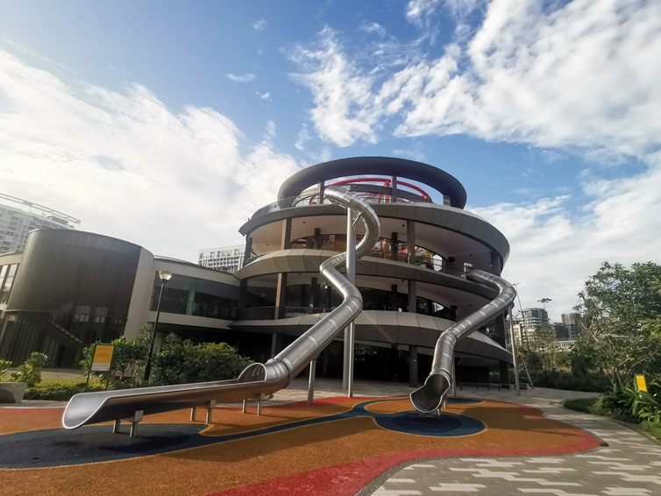
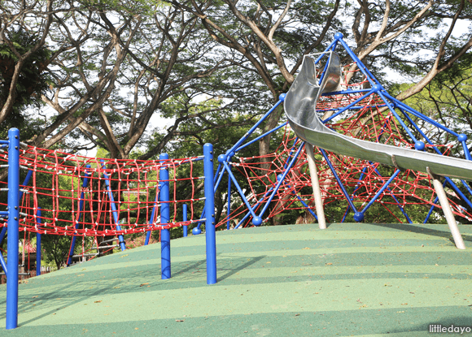
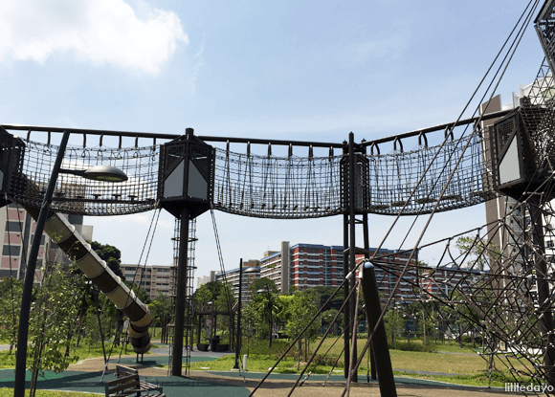
Exhibition Content: Playgrounds (Present)
1
2
3
(East Coast Park)
Coastal Playgrove
(Pasir Ris)
Pasir Ris Park Playground
(Tampines)
Tampines Green Forest Playground
(National Parks Board, 2021)
(Ng, 2014)
(Soh, 2017)

Slide 12
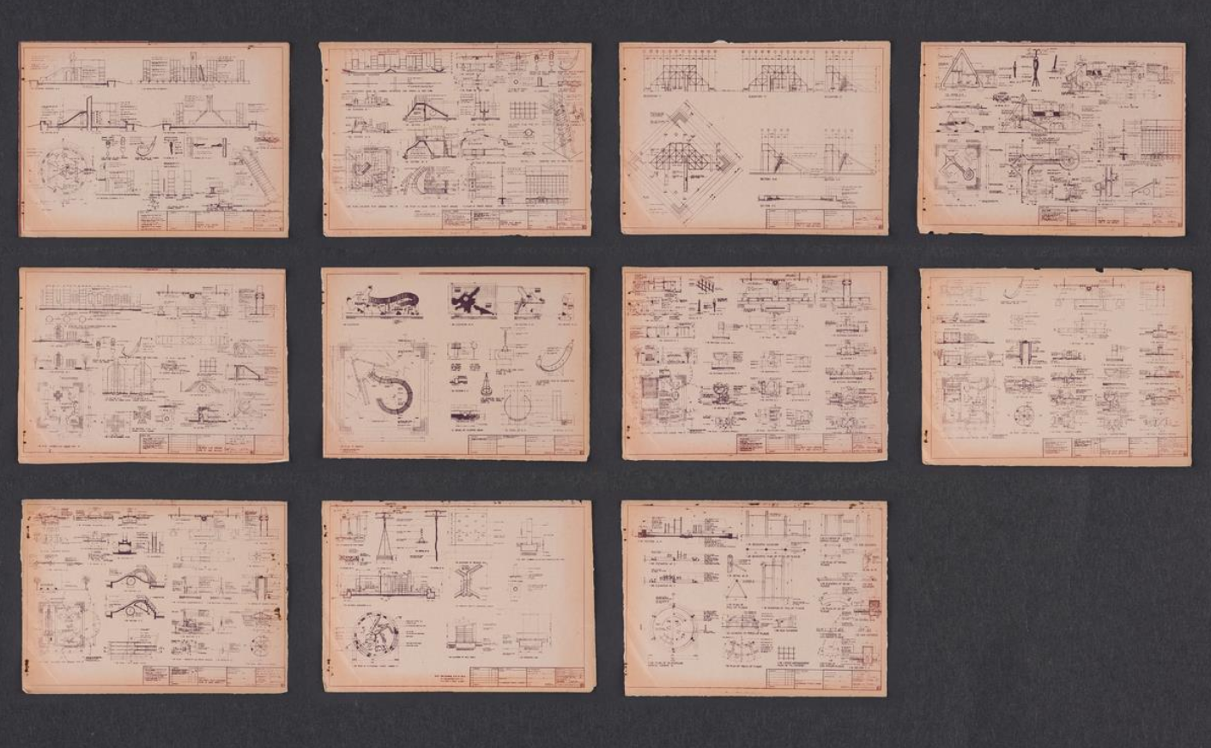
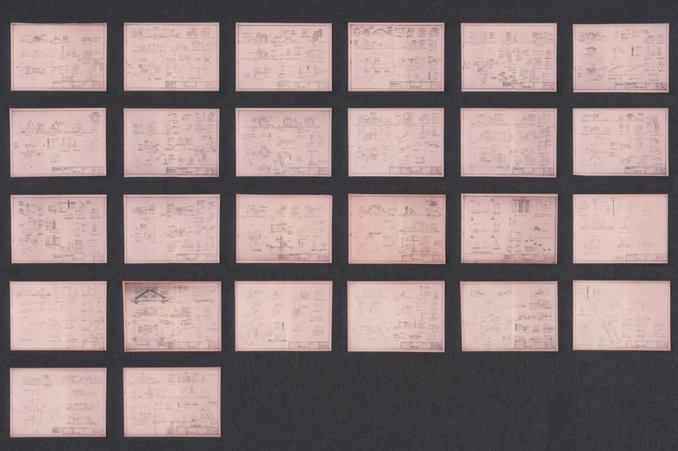
Exhibition Content: Playgrounds (Past)
Playground Prototype Drawings
Eye-opening photographs that can provide youth visitors with fascinating insights into how our local playgrounds from the past were designed and built
(Khor, n.d.-a)
(Khor, n.d.-b)

Slide 13
03
Exhibition Layout/Flow & Programme

Slide 14
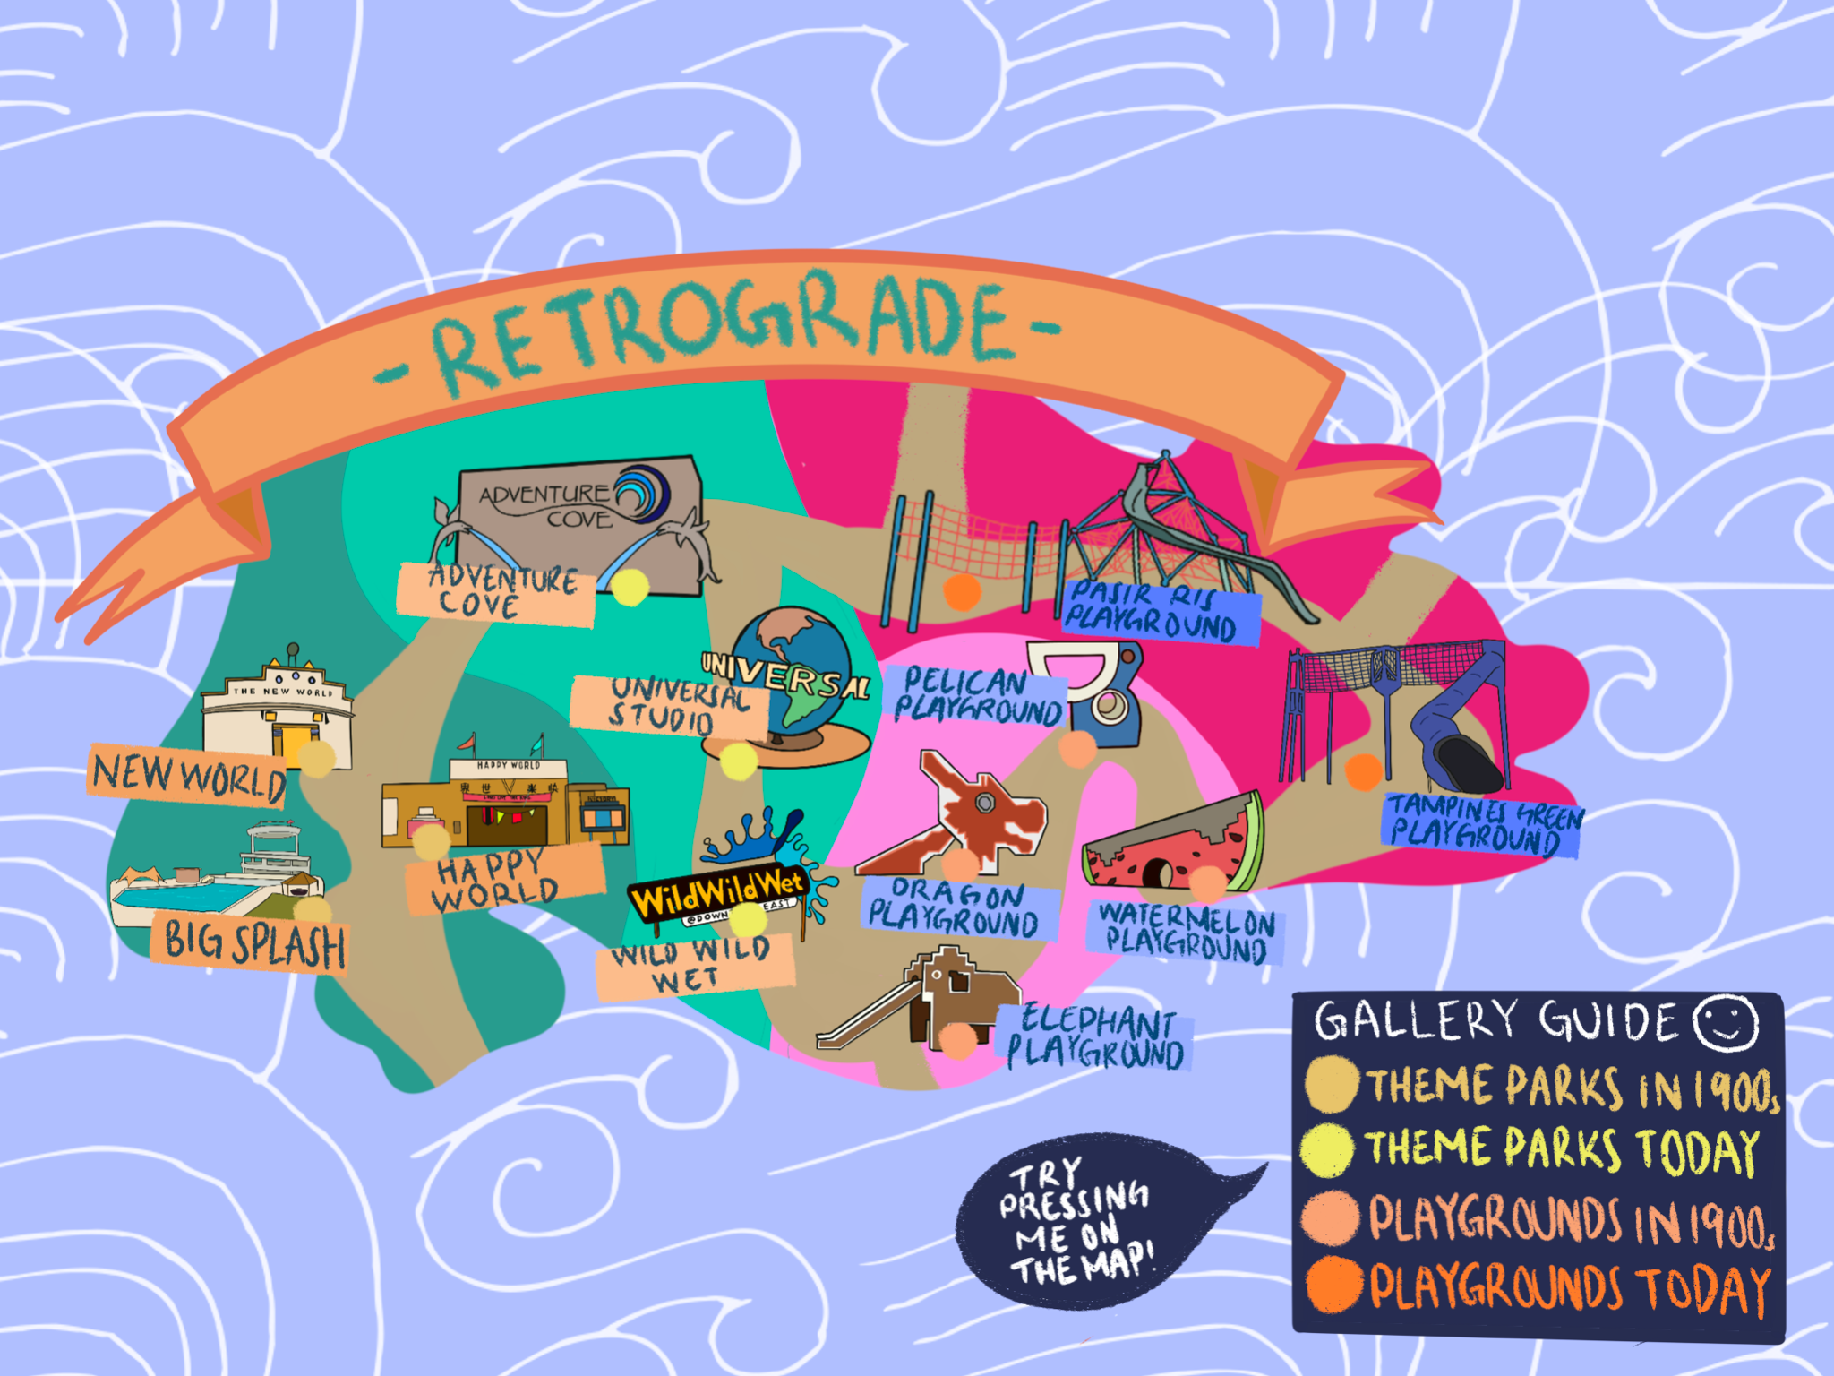

Exhibition Flow & Layout: Retrograde
[Exhibition Main Page]
Visitors will be greeted with the layout of a theme-park inspired map; outlining a timeline of recreational activities from different eras
Journeying from the past to present, visitors can explore a playground/theme-park in a 360° virtual space by clicking on the respective points
[Cartoon Dragon Virtual Exhibition Mascot}
To act as a virtual guide for Youth visitors

Slide 15
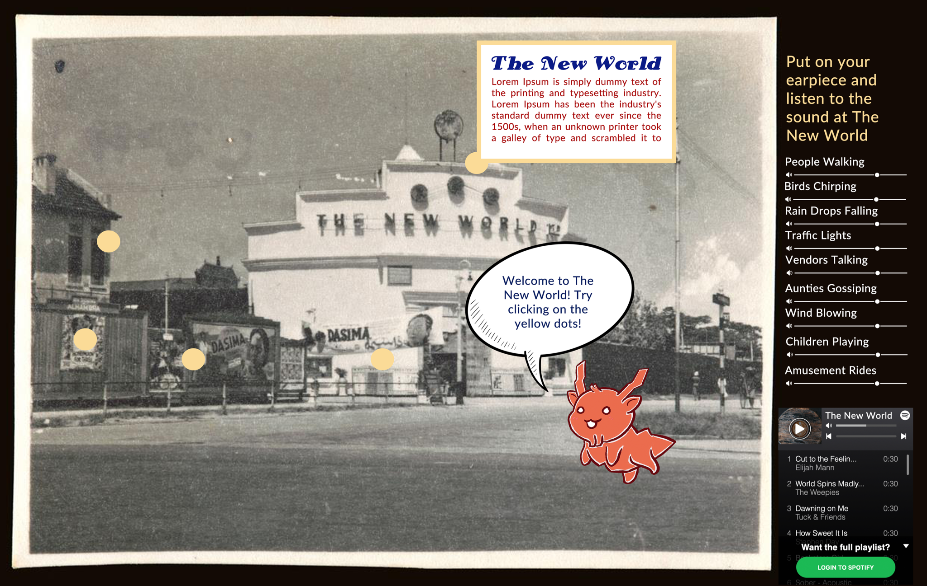
Exhibition Flow & Layout: Retrograde
[Individual 360° Virtual Space]
Upon ‘entering’ a selected playground/theme-park, all relevant information will be displayed through both:
Visual-Text & Audio means
One of the most appealing features of ‘Retrograde’: [A Spotify-inspired Playlist & Audio Control System]
There will be a variation of sound effects and music (songs) uniquely allocated to each playground/theme-park

Slide 16
Exhibition Plan & Layout: Retrograde
To enhance and replicate the environment and atmosphere of the playground or theme-park in their respective time era, the following sound effects and music (songs) will be displayed:
PAST
PRESENT
Theme-Parks:
Theme-Parks:
Popular old-time songs, olden theme-park entertainment sounds & noises, water splashing sounds
Modern pop songs, roller coaster noises, walking and chattering noises, photograph-taking noises
Playgrounds:
Playgrounds:
Popular old-time children songs, children saying traditional game phrases & birds-chirping, running & trees swaying noises
Modern pop songs, children saying modern game phrases, chattering noises, mobile phone sounds, children-playing noises

Slide 17
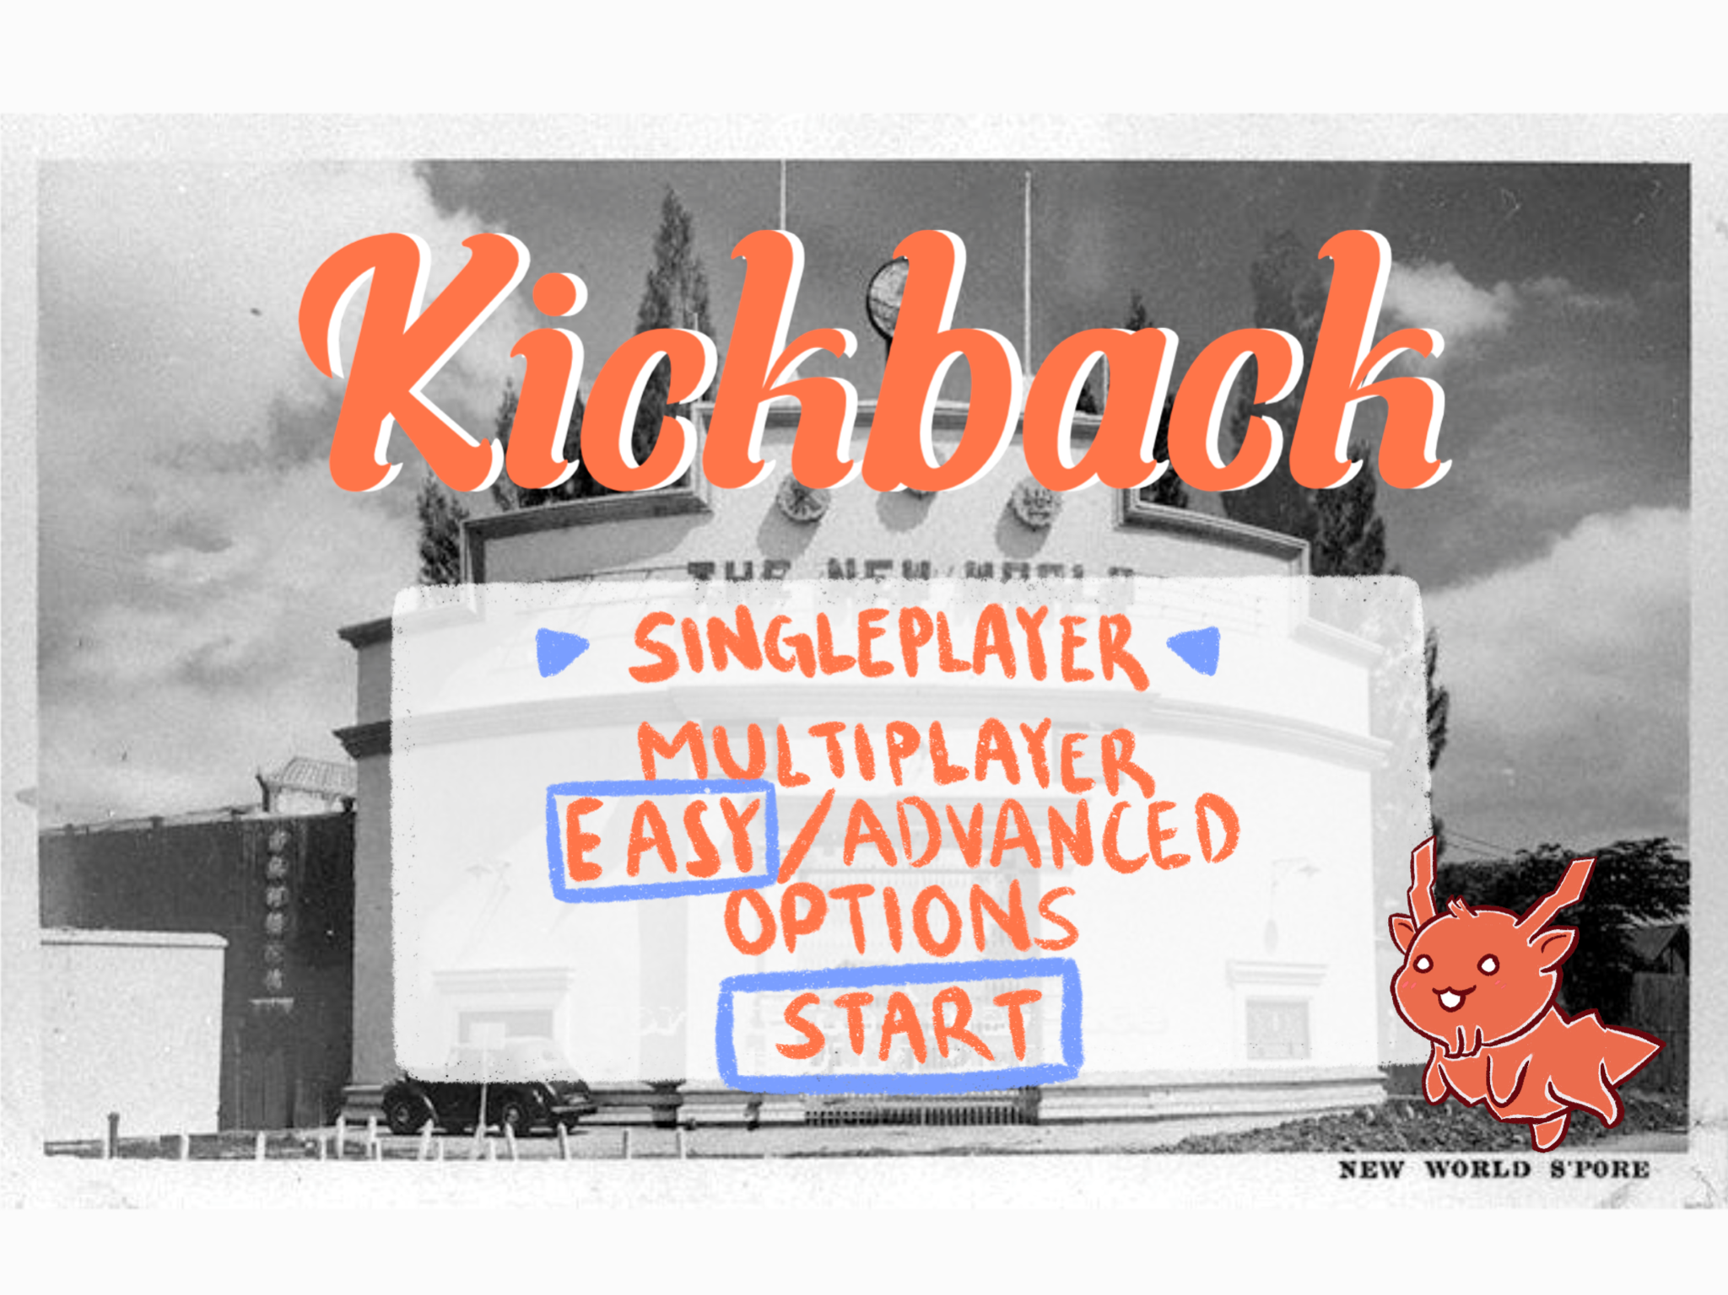
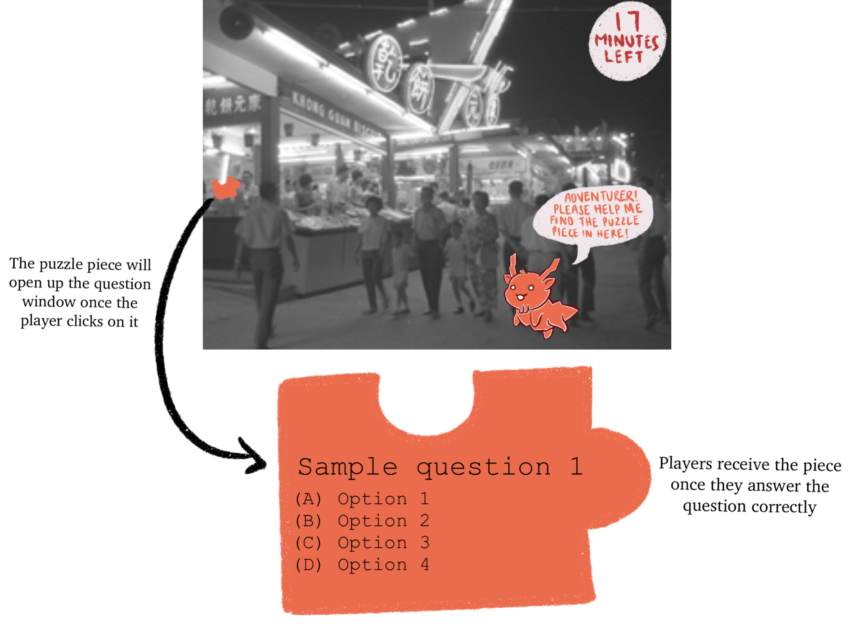
Programme Activity: Kickback
[Programme Main Page]
Two different play modes: Single-Player (solo visitors) & Multiplayer (group visitors)
Youth visitors can select from two different levels of difficulty
[Inside the Escape Room Activity]
Embedded sound elements with the same dragon virtual mascot
Takes youths on a 360° virtual space adventure in a pastime theme-park, to hunt for hidden puzzle pieces by answering questions correctly

Slide 18
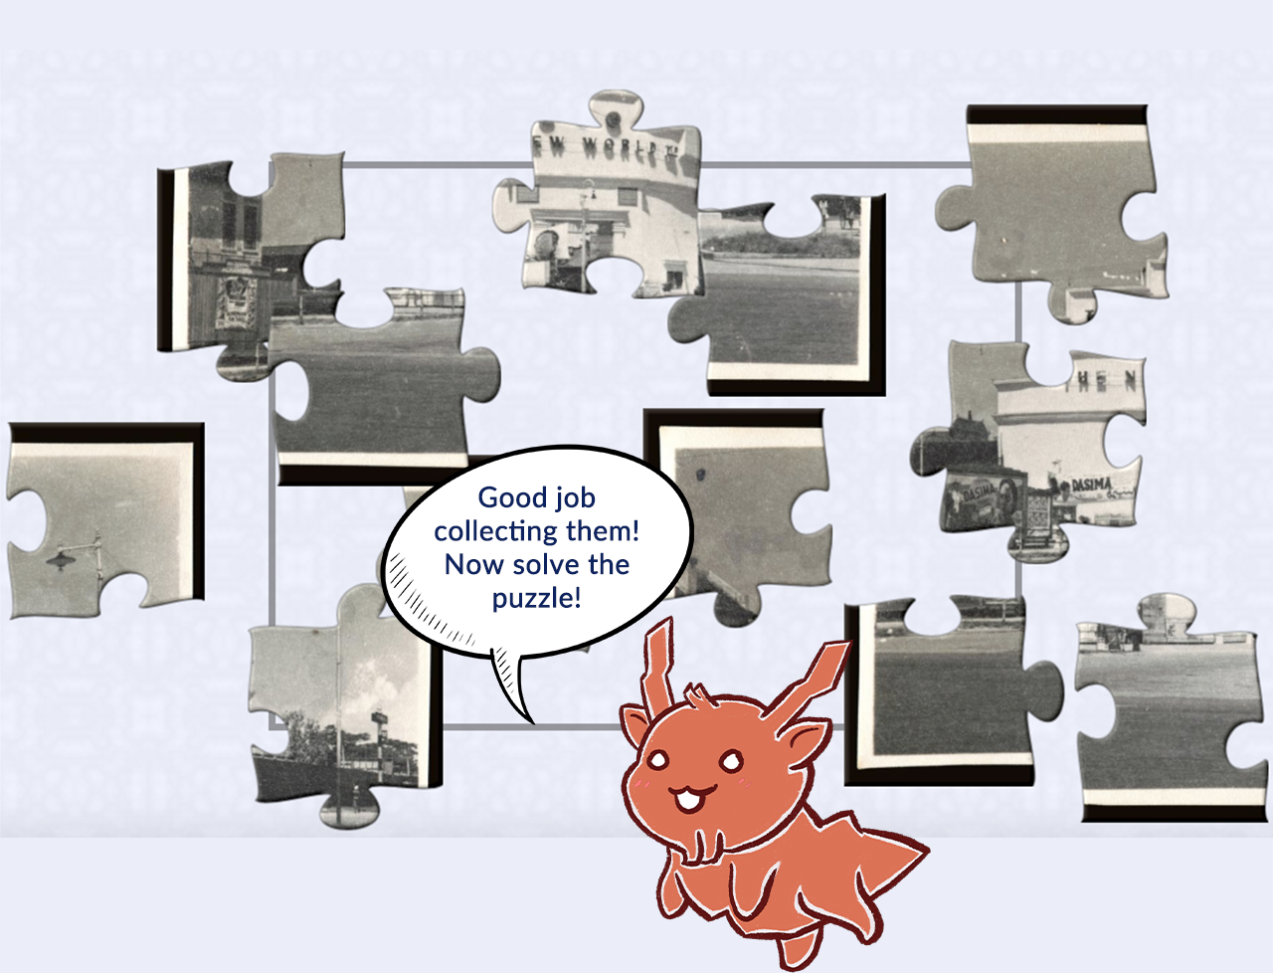
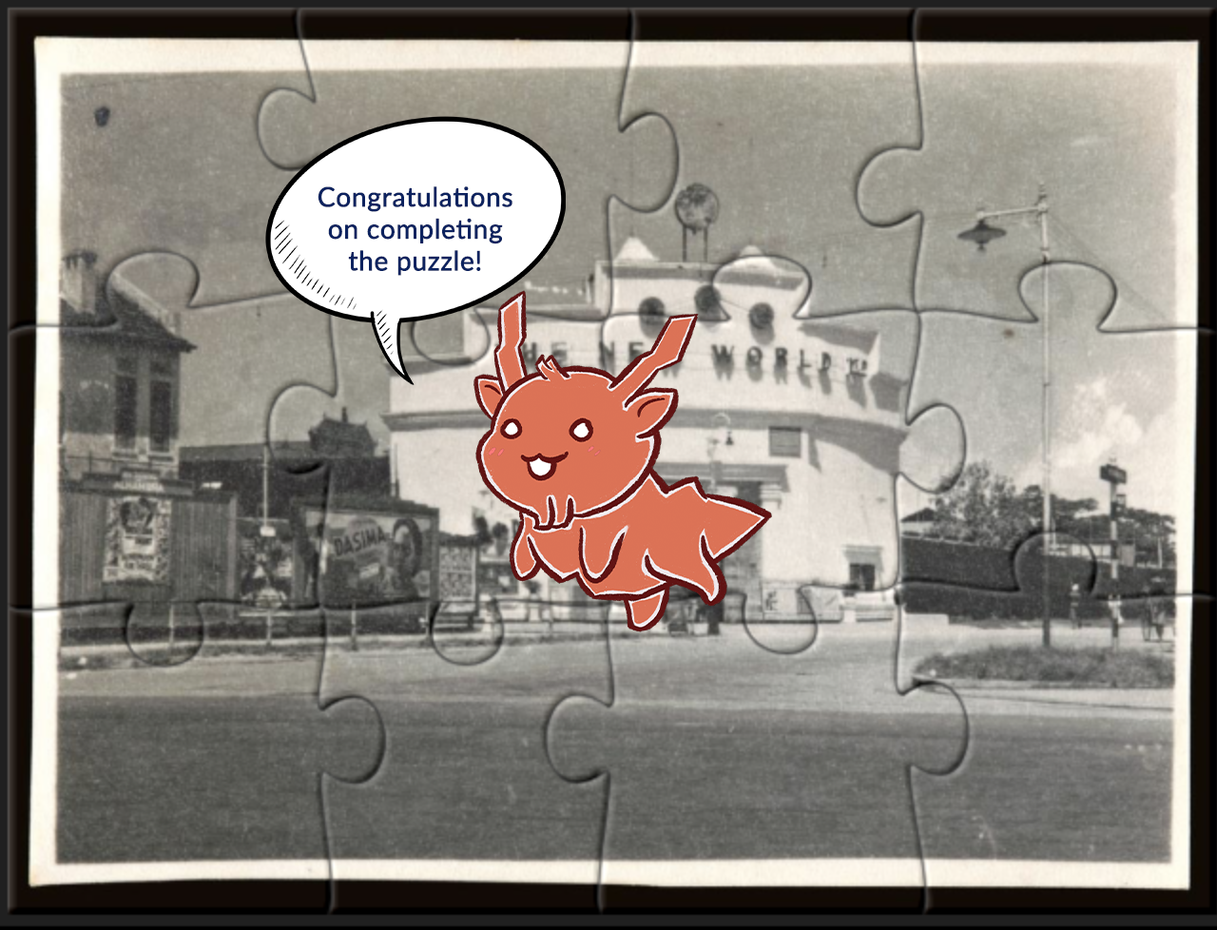
Programme Activity: Kickback
To increase game activity simulation, this exhibition escape room inspired game will have to be completed within a fixed time limit
[Completion of the escape room inspired game activity]
Once all puzzle pieces have been collected, players will have to piece them together
2 and 5 full puzzles will have to be formed for single players and multiplayers respectively, in order for players to ‘escape’ from the theme park

Slide 19
Incorporation of Current Trends:
To present a more interactive and engaging exhibition
1. 360° Tours
2. Guiding Persona
Enables better virtual experience as compared to static presentations of objects (Hoffman, 2020)
Guiding personas help to bridge audiences with the content presented (Gensler, 2020)

Slide 20
Incorporation of Current Trends:
3.
Technology
Sensorial Experience
Sound Effects & Music
Augments traditional experiences through sound applications
To hear sounds present in the past or exact environment
Amplifies the experience and enables visitors to gain deeper understanding
(Gensler, 2020)

Slide 21
Incorporation of Current Trends:
Mainstay of Successful Exhibitions
4. Narrative
Storytelling
Leslie Bedford: Renowned Museum Administrator & Author Approved
Deeper Understanding of Content
It imparts knowledge and understanding
“More than anything else...stories are powerful because they do not fill in all the blanks.”
Stories inspire an internal dialogue and thus ensure a real connection
(Gensler, 2020)

Slide 22
Incorporation of Current Trends:
5. Interface
Interface refers to the design of the webpage and it is everything in an online exhibition
The design of the website helps to distinguish the better exhibitions as everyone has the same toolbox to design their exhibitions
Detailed and careful attention will be placed on the user experience and interface of the exhibition website to ensure a smooth visitor experience
(Hoffman, 2020)

Slide 23
04
Target Profile & Visitor Motivations

Slide 24
Introduction: Youths’ Arts Profile
Levels of Arts Attendance:
Interest in Visual Arts:
Overall increase in arts attendance among Youths in 2019
Visual arts were ranked as Youths’ 3rd most frequented art form in 2019
Museums were ranked as their 4th most frequented venue for arts participation
(National Arts Council, 2019)

Slide 25
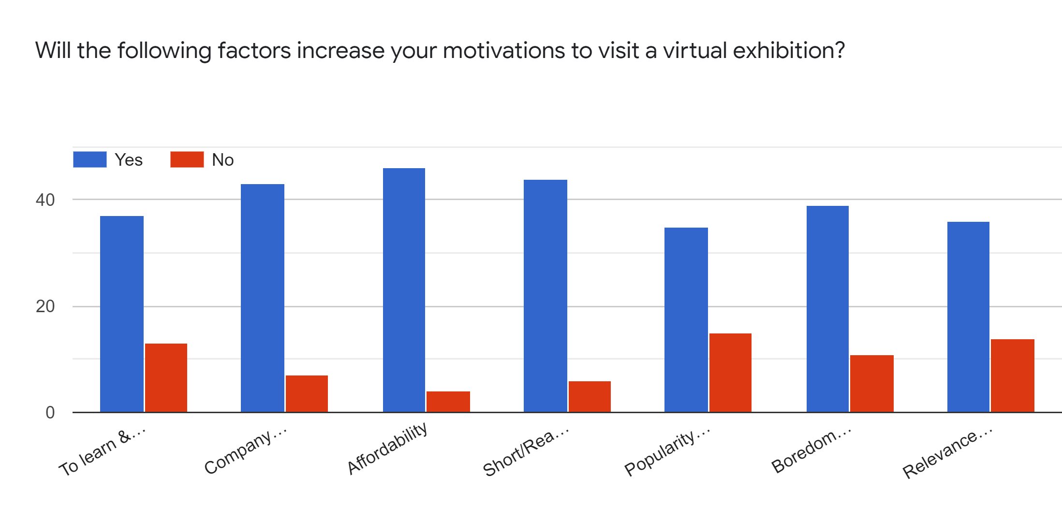
Knowledge & Relevance:
Youth Profile:
Motivators:
Acknowledge the importance of learning Singapore’s heritage
Youths are motivated by intrinsic factors such as gaining knowledge & relevance to their lives
Having a relatable topic is essential to motivate Youths
(Aziz, 2014)

Slide 26
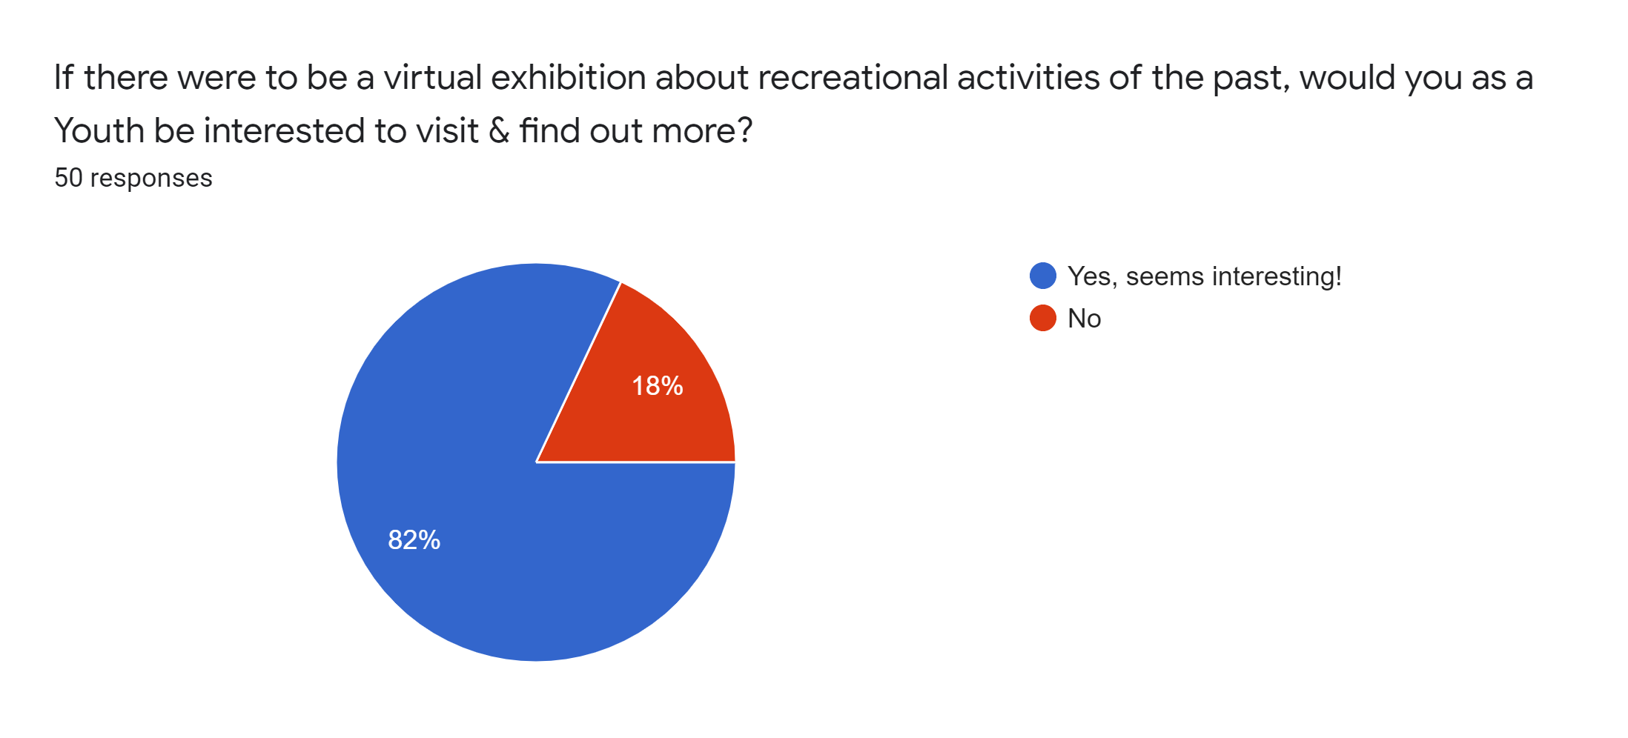
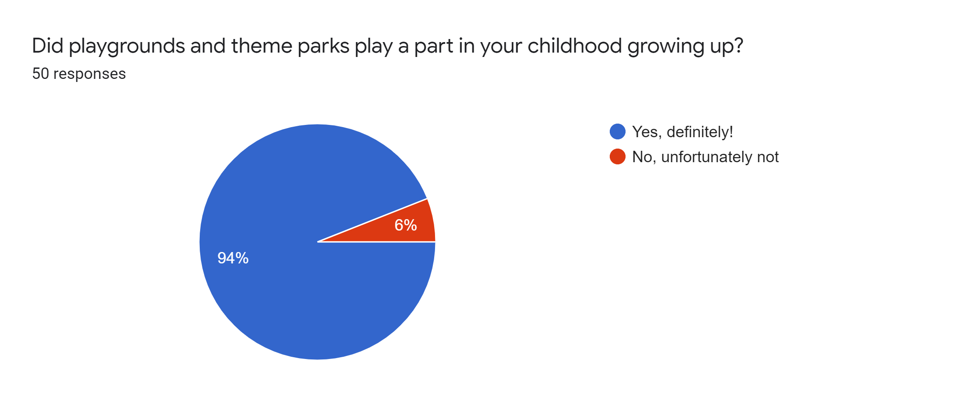
Knowledge & Relevance:
Interests:
Youths show interest in the idea of past and current recreational activities
Recreational activities played a huge part in many Youths’ childhoods
The concept of ‘Then vs. Now’ was a prominent suggestion
Therefore, this reinforces the effectiveness of the idea of presenting the theme of recreational activities to the Youth profile

Slide 27
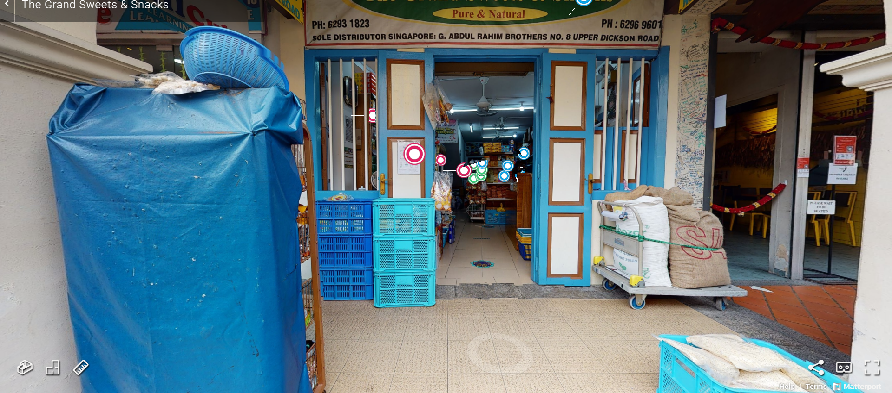
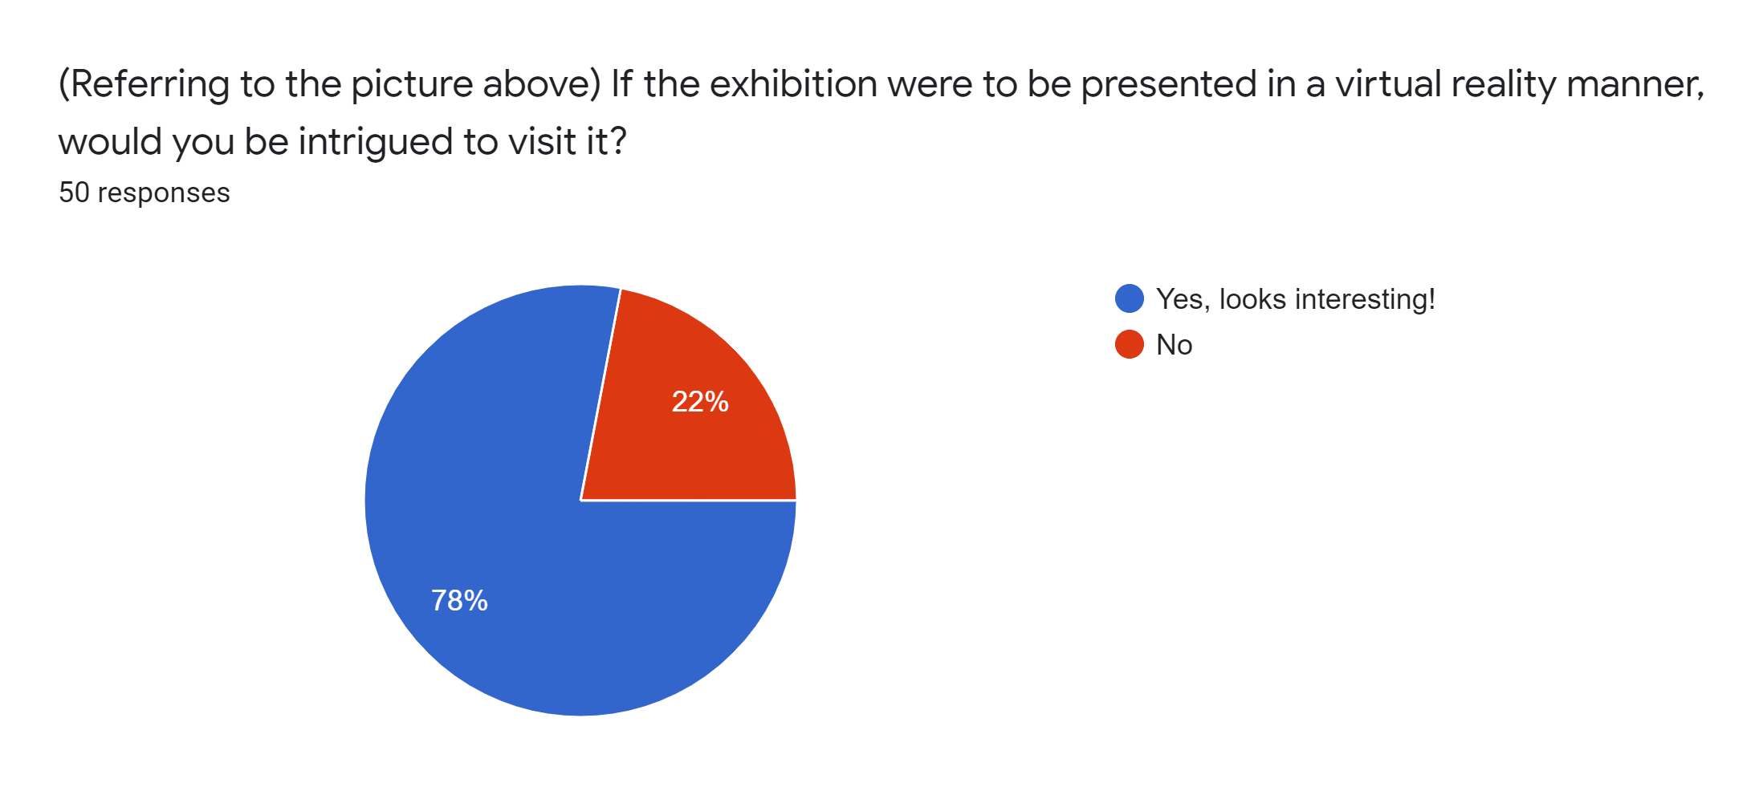
Gamification:
Interests in Technology:
Majority of Youths are digitally savvy (Basu, 2016)
A huge portion of Youths expressed interests in the concept of virtual reality
Incorporation of such technologies can better engage Youths (Basu, 2016)
(“The Grand Sweets & Snacks”, n.d.)
This further reinforces the appeal factor of presenting this exhibition to Youths in a 360° virtual space

Slide 28
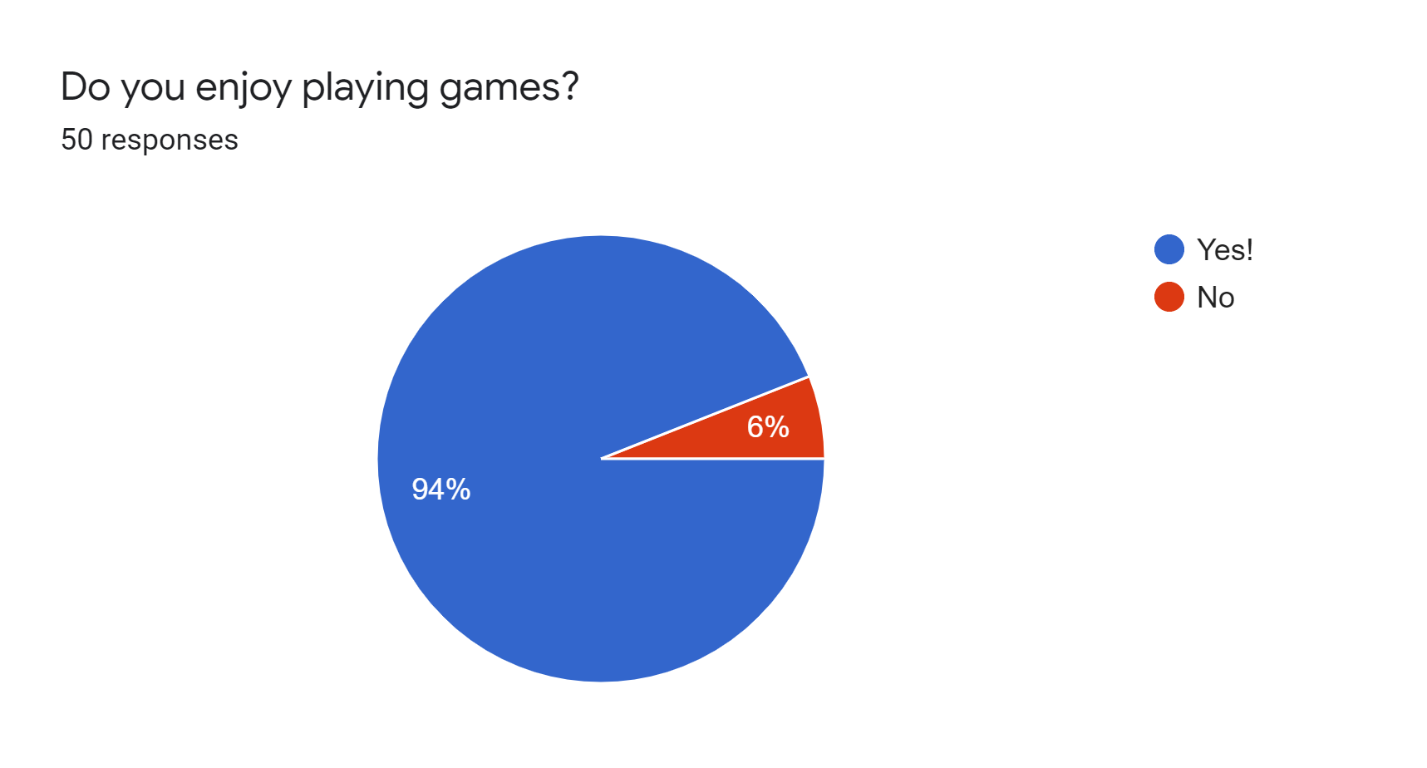
Gamification:
Interest in Games:
Motivators:
Video games are becoming an epidemic in this generation (Mummert, 2008)
Majority of Youths indicated enjoyment in playing games
Boredom cure is a popular motivator
Some prominent suggestions made by Youths are the inclusion of a virtual mascot & escape room
The above hence justify this exhibition’s overarching concept of gamification through the implementation of gamified elements like virtual reality, virtual mascot and time-limit

Slide 29

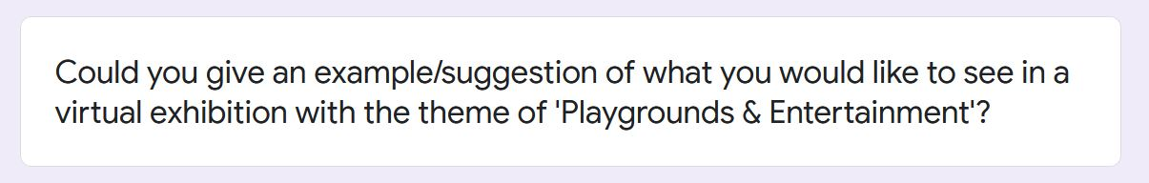

Music:
Significance:
Popular music reflects the culture of our day, representing a generation in the lyrics and sound of that era (Huang, 2015)
Relevance:
Spotify is the world’s most popular music streaming app (Stutz, 2015)
The above draws a clear connection to youths, hence emphasizing its appeal through suitability and relevance (key motivator)
(Willemsen, 2017)

Slide 30
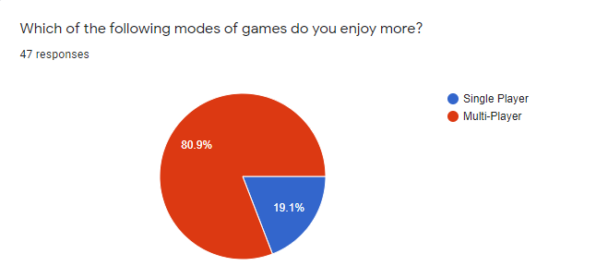
General Motivators:
Interaction with Others:
Survey responses showed an inclination towards interaction
76% indicated interest in multiplayer games
National Arts Council survey (2019): Nearly half cited friends as a driver for attendance
Affordability:
Most influential factor in participant motivation
92% of respondents agreed that it boosts an exhibition’s pull factor
Therefore, our exhibition has been catered towards group engagement and interaction at an affordable level, in line with our target audience’s interests

Slide 31
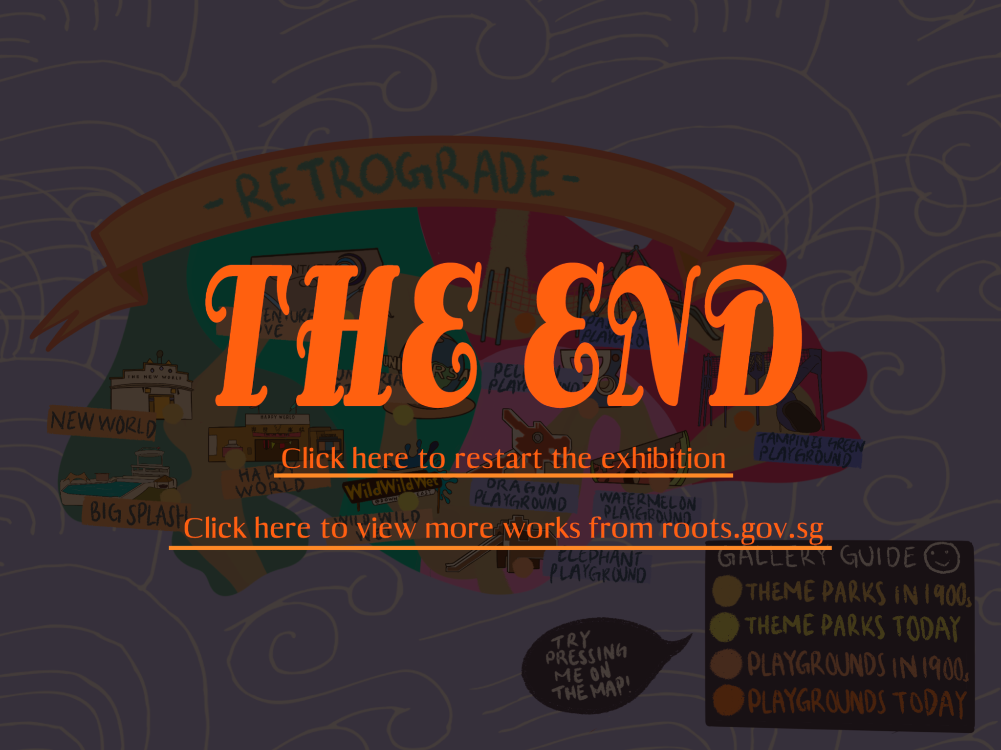
In Conclusion:
Why our exhibition?
Conceptualised with youths’ interests in mind
A beneficial & appealing extension of Roots Sg’s collections
Meaningful and encouraging in increasing Youths’ appreciation & awareness for our local arts & heritage values

Slide 32
The End
Thank You!

Slide 33
References
Aziz, M. A. (2014, January 27). Connecting Youth with S’pore’s Heritage. Today Online. Retrieved from https://www.todayonline.com/daily-focus/youth/connecting-youth-spores-heritage
Basu, M. (2016). How can Singapore’s museums attract millennials? Retrieved from https://govinsider.asia/innovation/how-can-singapores-museums-attract-millennials/
Gensler, L. D. (2020). The Power of Storytelling (Order No. 28315051). Available from ProQuest Central. (2479729252). https://www-proquest-com.proxy.lib.sg/dissertations-theses/power-storytelling/docview/2479729252/se-2?accountid=12691
Huang, B. (2015). What Kind of Impact Does Our Music Really Make on Society?. Retrieved from https://blog.sonicbids.com/what-kind-of-impact-does-our-music-really-make-on-society

Slide 34
References
Hoffman, S. K. (2020). Online Exhibitions during the COVID-19 Pandemic. Museum Worlds, 8(1), 210-215. http://dx.doi.org/10.3167/armw.2020.080115
Khor, E. G. (n.d.-a). HDB Playground Prototype Drawings [Online image]. Roots. https://www.roots.gov.sg/Collection-Landing/listing/1279229
Khor, E. G. (n.d.-b). HDB Playground Prototype Drawings from 1970s-80s [Online image]. Roots. https://www.roots.gov.sg/Collection-Landing/listing/1277345
Mummert, J. (2008). Why Do Kids Become Addicted to Video Games?. Retrieved from http://EzineArticles.com/1483472
National Arts Council. (2019). National Arts Council Population Survey on the Arts. [PDF file]. Retrieved from
https://www.nac.gov.sg/dam/jcr:3d6bb167-7933-4326-9467-9f05bb4e7206

Slide 35
References
National Parks Board. (2021). Coastal Playgrove [Online image]. National Parks Board. https://www.nparks.gov.sg/gardens-parks-and-nature/parks-and-nature-reserves/east-coast-park/coastal-playgrove
Ng, L. (2014). Pasir Ris Park: Playground Rediscovered [Online image]. Little Day Out. https://www.littledayout.com/pasir-ris-park-playground-rediscovered/
Rosie. (n.d.). Adventure Cove at Marine Life Park Sentosa [Online image]. Adventures With Family. https://www.adventureswithfamily.com/adventure-cove-at-marine-life-park/
Roots. (n.d.-a) Great World Amusement Park [Online image]. Roots. https://www.roots.gov.sg/Collection-Landing/listing/1262580

Slide 36
References
Roots. (n.d.-b) New World Amusement Park [Online image]. Roots. https://www.roots.gov.sg/Collection-Landing/listing/1262050
Roots. (n.d.-c). Elephant Playground [Online image]. Roots. https://www.roots.gov.sg/places/places-landing/Places/landmarks/Pasir-Ris-Heritage-Trail/elephant-playground
Roots. (n.d.-d). Happy World Amusement Park [Online image]. Roots. https://www.roots.gov.sg/Collection-Landing/listing/1096162
Roots. (n.d.-e). Playgrounds of the Past [Online image]. Roots. https://www.roots.gov.sg/stories-landing/stories/playgrounds-of-the-past/story
Roots. (n.d.-f). Tampines Central Park [Online image]. Roots. https://www.roots.gov.sg/places/places-landing/Places/landmarks/tampines-heritage-trail-tampines-town-trail/Tampines-Central-Park

Slide 37
References
Roots. (n.d.-g). The Big Splash aquatic centre [Online image]. Roots. https://www.roots.gov.sg/Collection-Landing/listing/1109395
Stutz, C. (2015). Spotify Tops Pandora as World's Most Popular Music Streaming App. https://www.billboard.com/articles/news/6784774/spotify-pandora-most-popular-music-streaming-app-worldwide
Soh, C. (2017). Tampines Green Forest Park & Playground: Cargo Net Course [Online image]. Little Day Out. https://www.littledayout.com/tampines-green-forest-park-playground-cargo-climb/
“The Grand Sweets & Snacks”. (n.d.) The Grand Sweets & Snacks. Retrieved from https://my.matterport.com/show/?m=rtRmqs2MVQJ

Slide 38
References
Tristram, T. (2019). Ultimate Guide to Universal Studios Singapore for Kids [Online image]. Honey Kids. https://honeykidsasia.com/ultimate-guide-to-universal-studios-singapore/
Willemsen, M. (2017). Beats and Brands: Using Spotify for Your Marketing Efforts. Negocia Group. http://negociagroup.com/featured/beats-brands-using-spotify-marketing-efforts/
Wild Wild Wet. (n.d.). Downtown East Tenant Deals [Online image]. Wild Wild Wet. https://www.wildwildwet.com/TenantsExclusive20

Slide 39
Thanks!
Do you have any questions?
youremail@freepik.com
+91 620 421 838
yourcompany.com
Please keep this slide for attribution

